Slide 1
Unity Get Started
Presented by Ksenia Kaganer

Slide 2


2D/3D Game Engines
Handles physics, lightning, shading, audio, effects and more

Slide 3

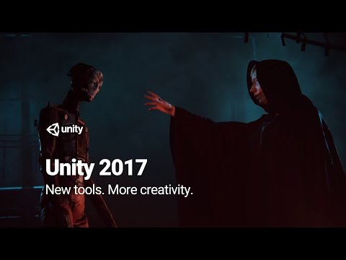


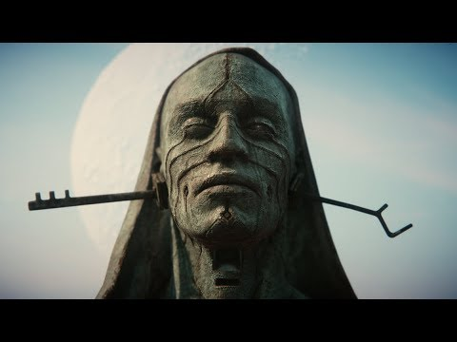
Eventually we create Amazing Graphic Applications

Slide 4
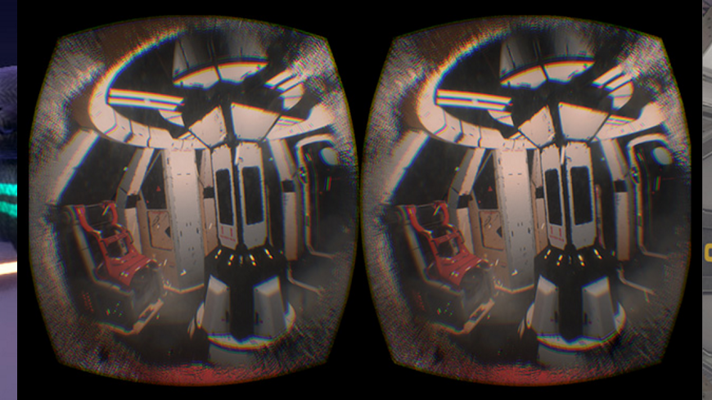
Why Unity?
Free
Cross platform
High quality
Well documented
Lots of tutorials
Wide Community
Wide selection of assets - https://www.assetstore.unity3d.com/en/
Coding is done in C# or JS

Slide 5
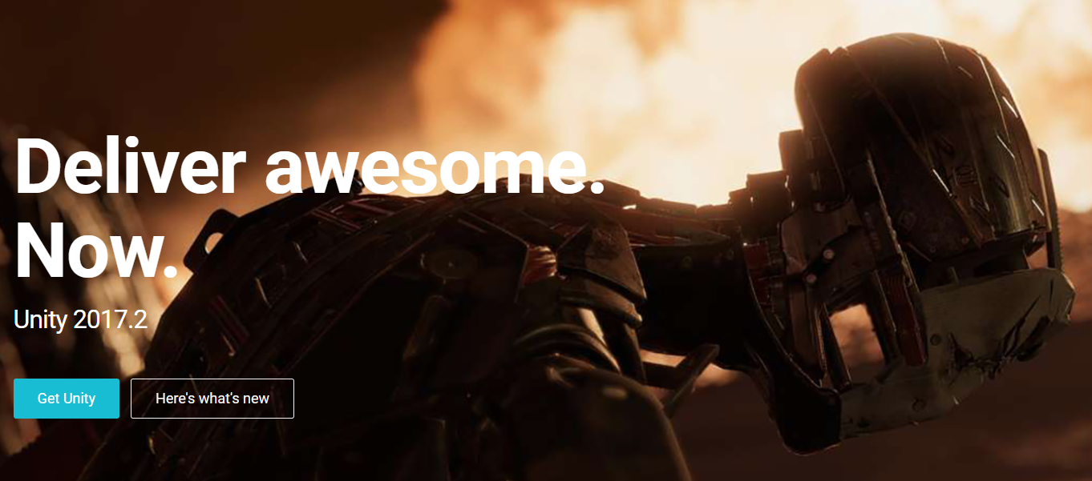
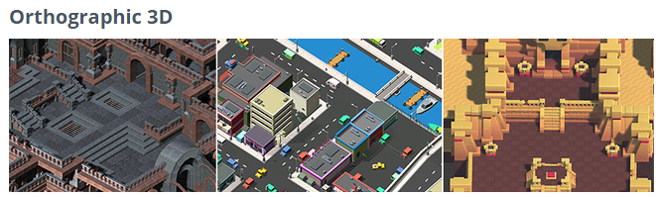
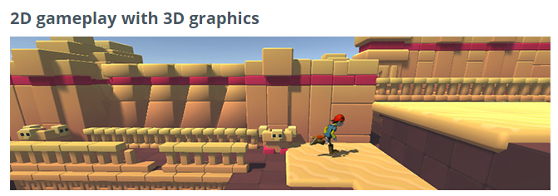
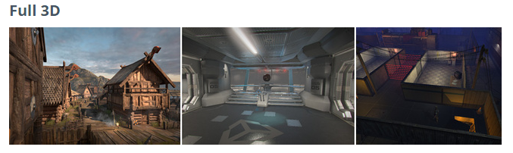
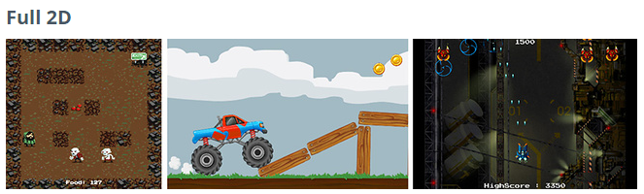
Unity Game Engine
Download and Installing
Unity Personal Edition:
https://unity3d.com/get-unity/download?ref=personal
Unity Previous Versions:
https://unity3d.com/get-unity/download/archive
Unity Documentation:
https://docs.unity3d.com/Manual/UnityManual.html
Unity Learn:
https://unity3d.com/learn

Slide 6

Hello Unity
Create new project
Learning the Interface
Assets - Import assets
Unity Scene Manage
Create Unity Scene
Create and Manipulate Scene Objects
Camera + skybox
Lighting
Terrain
Best Practice
Projects planning
Prefabs
Export Assets
Scripts
Events (keyboard, mouse…)
Physics (Rigidbody) + Mesh Colliders
Material & texture
Animation
Audio + Video
UI
Game Features
Creating player & controls and activities
Navigation and Pathfinding
Work with external devices (LeapMotion, HTC Vive, Oculus Rift, Controllers…))
General AR VR Technology
Build Version - Deployment (VR, AR, mobile)

Slide 7
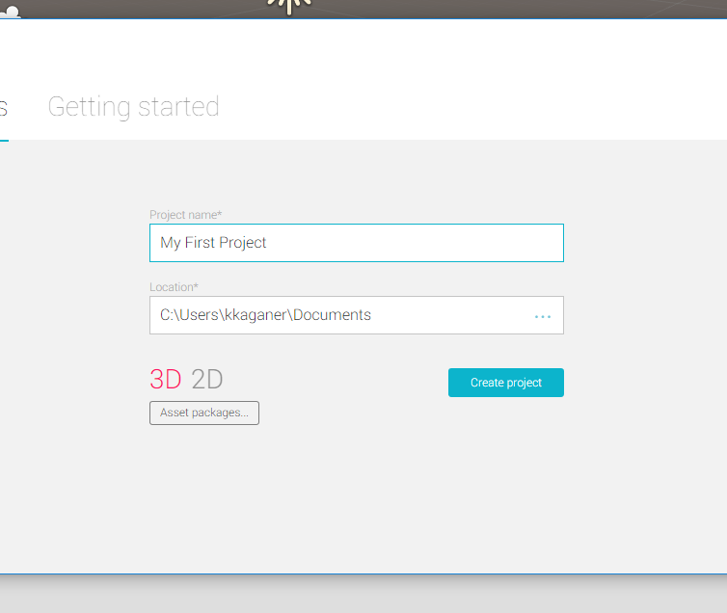
Create New Project
Project name
Location
Asset Packages: You can add assets you purchased.

Slide 8
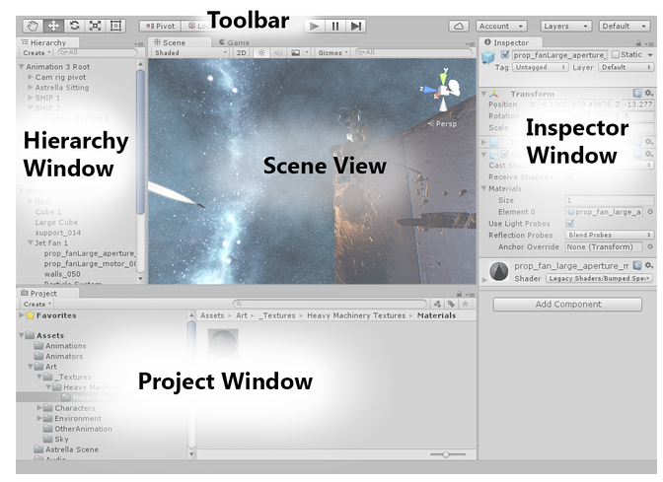
Learning
the
Interface
You can move and resize all the windows of your workspace

Slide 9
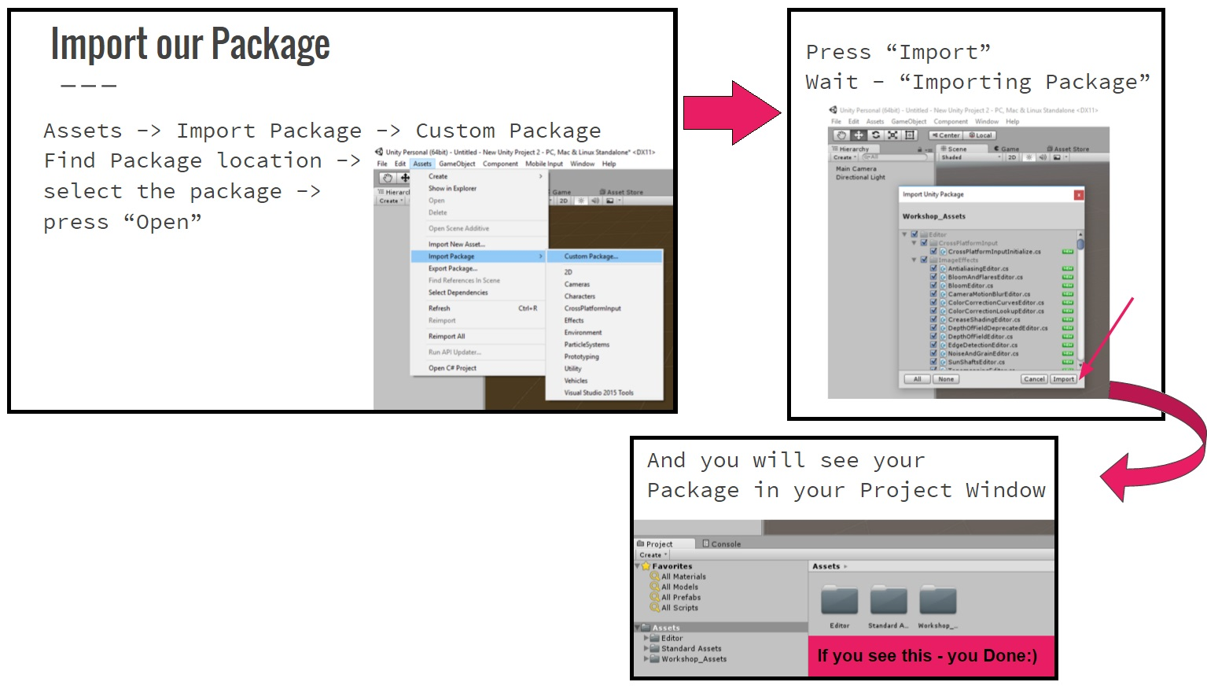
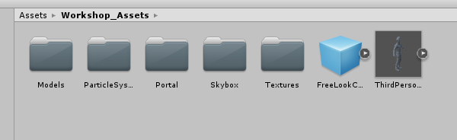
Import Assets
You’ll find everything you need in the Workshop_Package

Slide 10
Unity Scene Manage
Create Unity Scene - Right click in the “Project Window” -> Create->Scene Name your scene (You can get your scene by its name or build index). Notice that our application can consist of multiple scenes.
Next slides we discuss about:
Create and Manipulate Scene Objects
Camera
Lighting
Terrain

Slide 11
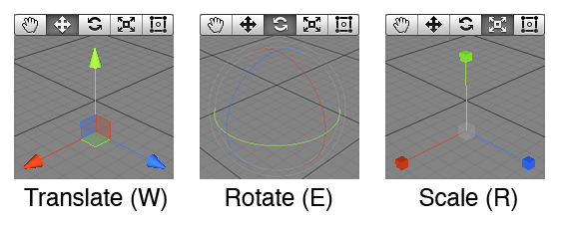
First Let’s get used
to the 3D World
GameObject -> 3D Object -> Cube
Left mouse button
Pan around
Position on the axises
Rotation
Scale tool - by clicking on the middle it will scale on all axises or separately.
Right mouse button move your “editor camera”

Slide 12
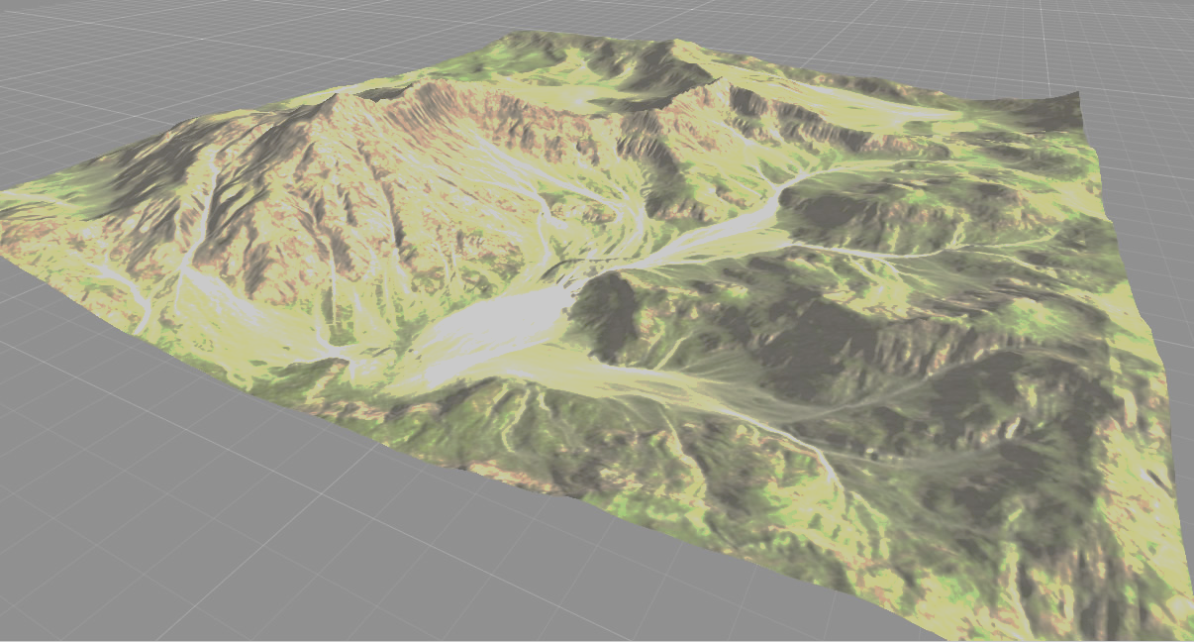
Camera - Light - Terrain
Our Scene automatically created with Camera and Directional light.
GameObject -> Camera
GameObject -> Light -> Directional light
GameObject -> 3D Object -> Terrain
Or right click in the “Hierarchy Window”
*Camera -> Add Component -> Skybox ->Custom Skybox
*Inspector -> Brush icon -> Edit Textures -> Add Texture
Now it’s just look too FLAT - Let's add some Mountains and stuff

Slide 13
Best Practices
Git Repository
Project Planning
Special folder naming
Organize your Assets
Prefabs
Export assets

Slide 14
Organize your Assets
My tree goes like this:
_common
_game
Animation
Prefabs
<game specific subfolder hierarchy>​
Scenes
Scripts
<game specific subfolder hierarchy>​
UI
images
fonts
prefabs​
<third party>
<third party>
<third party>
...
In general there are two main approaches to organize assets: by type or by relevance.
First option works good with small projects, second one is better for huge games, also you can combine and get something in middle http://devmag.org.za/2012/07/12/50-tips-for-working-with-unity-best-practices/

Slide 15
Organization Tips
Don't move third-party Asset Store products. Leave them in their original import locations. Some of them still expect to run in hard-coded paths. Also, if you update a package that contains new files, the new files will be imported into the original import location, which makes a mess.
Organize your own assets (code, textures, models, etc.) under a single folder. I prefer "_Project" because the underscore makes it sort to the top of the folder list. Or maybe two folders, "_Project" and "_Framework" (or "_Game" and "_Common").
Inside "_Project", organize folders to maximize your team's workflow. Art assets tend to be the problem area since there are usually so many files.
If your game is divided into sections (e.g., levels) with distinct sets of art, consider folders for each section (e.g, Mushroom Kingdom, Sewers, Dracula's Castle, etc.).
If your game reuses most of its art across levels, consider folders for each function instead: Scenes, ParticleEffects, Characters, etc.
I've found that it works best to group all assets related to an entity in a single folder. So, for example, you might have a "Dragon" folder with subfolders for Dragon-specific textures, models, animation, particle effects, and audio clips.
The goal is to establish a folder structure that allows artists and co-workers to find assets easily and avoid messing with assets that they're not currently working on.

Slide 16
Special folder names
https://docs.unity3d.com/Manual/SpecialFolders.html
Assets
The Assets folder is the main folder that contains the Assets used by a Unity project.
Resources
You can load Assets on-demand from a script instead of creating instances of Assets in a Scene for use in gameplay. You do this by placing the Assets in a folder called Resources. Load these Assets by using the Resources.Load function.
Editor
Scripts placed in a folder called Editor are treated as Editor scripts rather than runtime scripts. These scripts add functionality to the Editor during development, and are not available in builds at runtime.
Plug-ins
You can add plug-ins to your Project to extend Unity’s features. Plug-ins are native DLLs that are typically written in C/C++. They can access third-party code libraries, system calls and other Unity built-in functionality. Always place plug-ins in a folder called Plugins for them to be detected by Unity.

Slide 17
Prefabs
It is convenient to build a GameObject in the scene by adding components and setting their properties to the appropriate values.
If your object is reused in the scene several times. Simply copying the object will certainly produce duplicates but they will all be independently editable.
Generally, you want all instances of a particular object to have the same properties, so when you edit one object in the scene, you would prefer not to have to make the same edit repeatedly to all the copies.
You can create a prefab by selecting
Asset > Create Prefab and then dragging an object from the scene onto the “empty” prefab asset that appears or simply drag the obje.
If you then drag a different GameObject onto the prefab you will be asked if you want to replace your current gameobject with the new one. Simply dragging the prefab asset from the project view to the scene view will then create instances of the prefab.

Slide 18
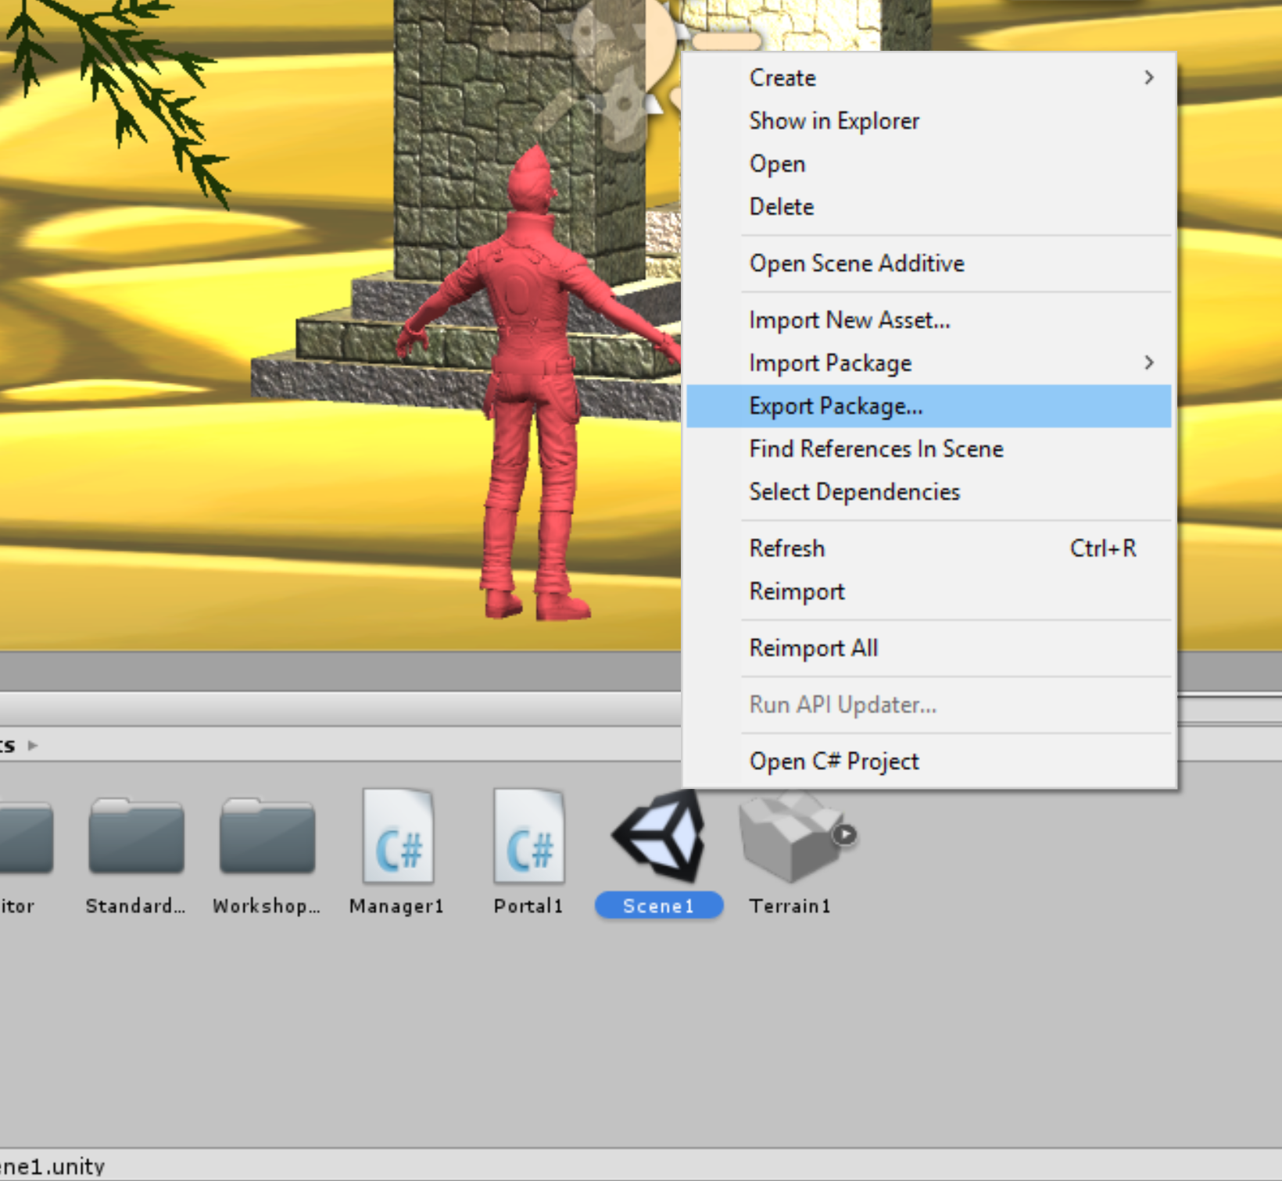
Export Assets
Right click in your “Project Window” ->
Export Package...

Slide 19
Scripts
Most of the scripts inherit from Monobehaviour Class
Start Function
Update Function
public static GameObject Find(string name); public static GameObject[] FindGameObjectsWithTag(string tag);
public Component GetComponent(Type type); public Component[] GetComponentsInChildren(Type t, bool includeInactive = false);
public void Invoke(string methodName, float time); public void InvokeRepeating(string methodName, float time, float repeatRate);
public static void Debug.Log(object message);
public static void Debug.Log(object message, Object context);

Slide 20
Examples
Color your Character
GameObject myController;
void Start () {
myController = GameObject.Find("ThirdPersonController");
Invoke ("colorRed", 30f);
}
void colorRed(){
myController.GetComponentInChildren<Renderer>().material.color
= Color.red;
}
In the Project Window:
Create->C# Script
GameObject->Create Empty
Drag your script into the
Empty Object you created.
Or on Any specific GameObject in the Scene.
public GameObject firework;
void Start () {
Invoke ("doFireworks", 40f);
}
void doFireworks(){
firework.SetActive (true);
}
void OnCollisionEnter(Collision col){
if(col.gameObject.name == "ThirdPersonController"){
gameObject.GetComponent<Animation> ().Play ("jump");
}
}
My Spider Animation
Fireworks:)

Slide 21
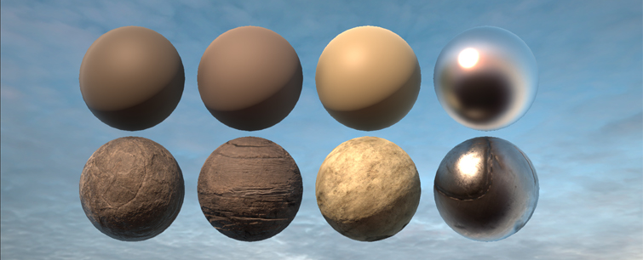
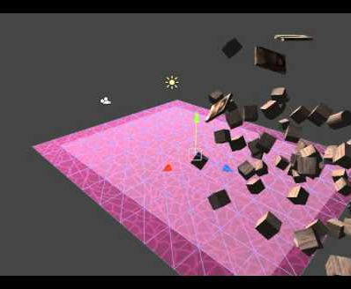
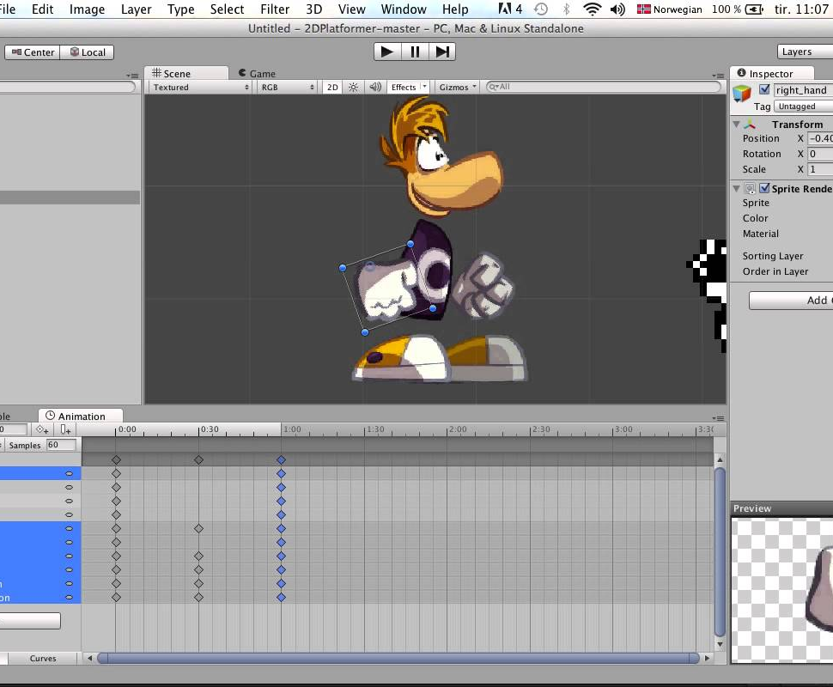
Events (keyboard, mouse…)
Physics (Rigidbody) + Mesh Colliders
Material & texture
Animation
Audio + Video
Let’s Jump back to Unity!

Slide 22
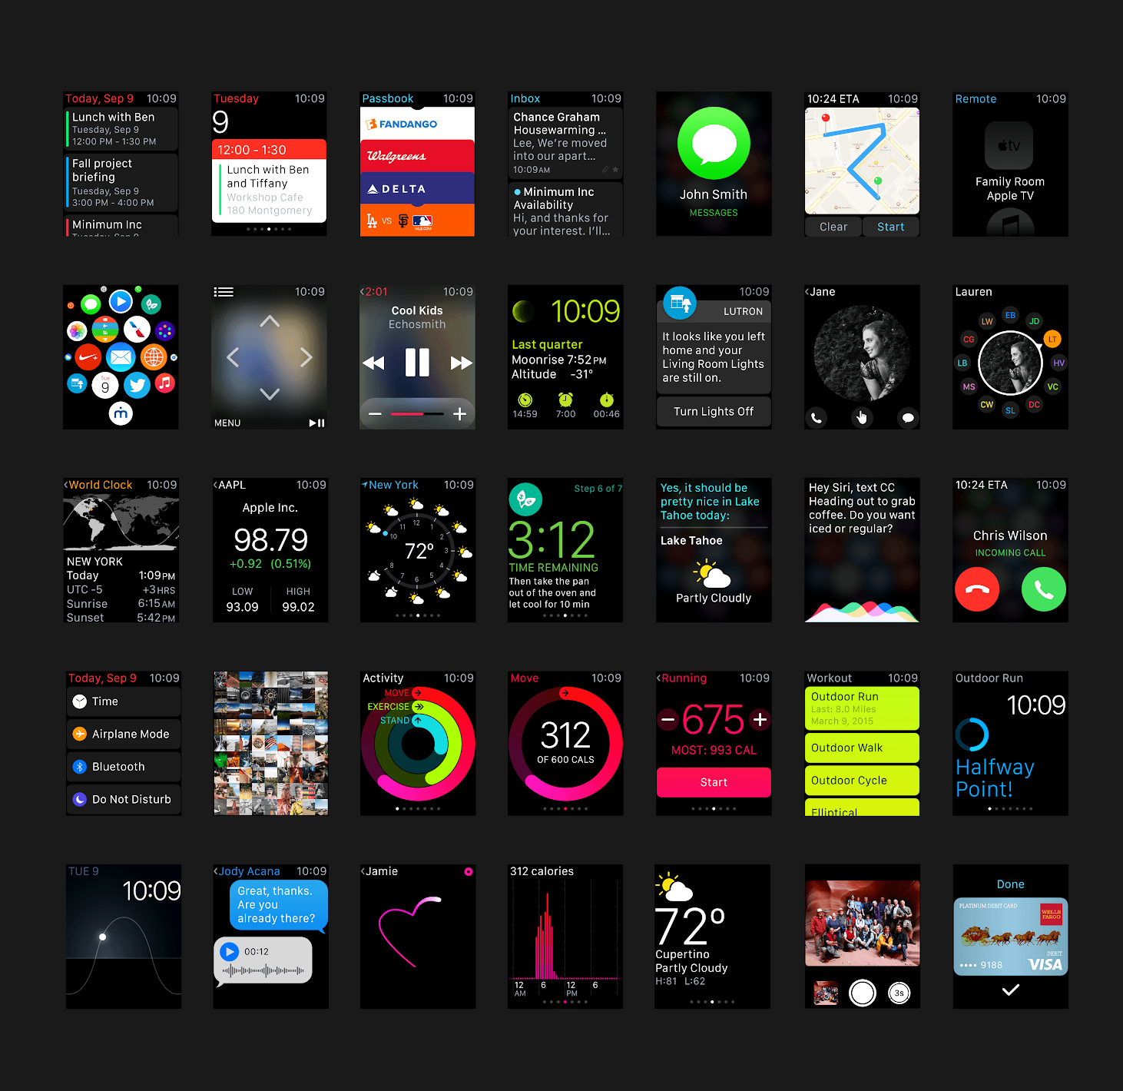
UI
GameObject->UI->text
vertical/Horizontal overflow Text
GameObject->UI->Image
(To add an image simply drag it into the project window and change the Texture Type - Sprite 2D and UI)
GameObject->UI->Button
In The Inspector TAB->Button Component
Press + and drag the Canvas object into the object field->GameObject->SetActive

Slide 23
Gameplay
Environment
Server
Controls
Activities
Navigation and Pathfinding
Cinemachine

Slide 24
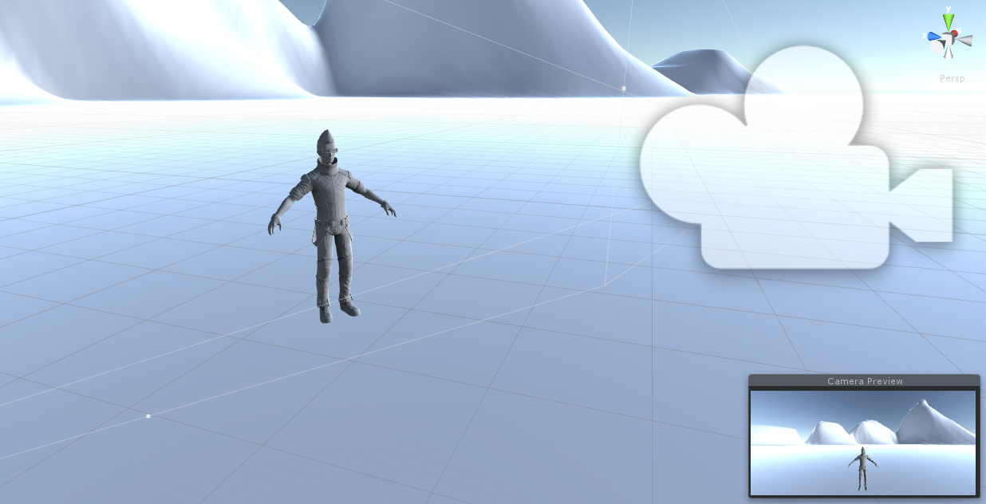
Player & Controls & Activities
You have various Motion and controls examples in the Standard Assets package!
Player - Must have Collider and Rigidbody
to have physical motion.
Controls - Are usually written in a Character Control Script
that triggers the relevant events.
Activities - Are most likely a set of animations!

Slide 25
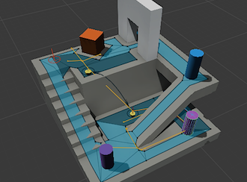
Navigation and Pathfinding
https://docs.unity3d.com/Manual/Navigation.html
Let’s see some examples:
https://www.assetstore.unity3d.com/en/#!/content/5328

Slide 26
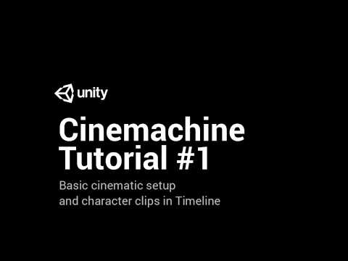
Cinemachine

Slide 27
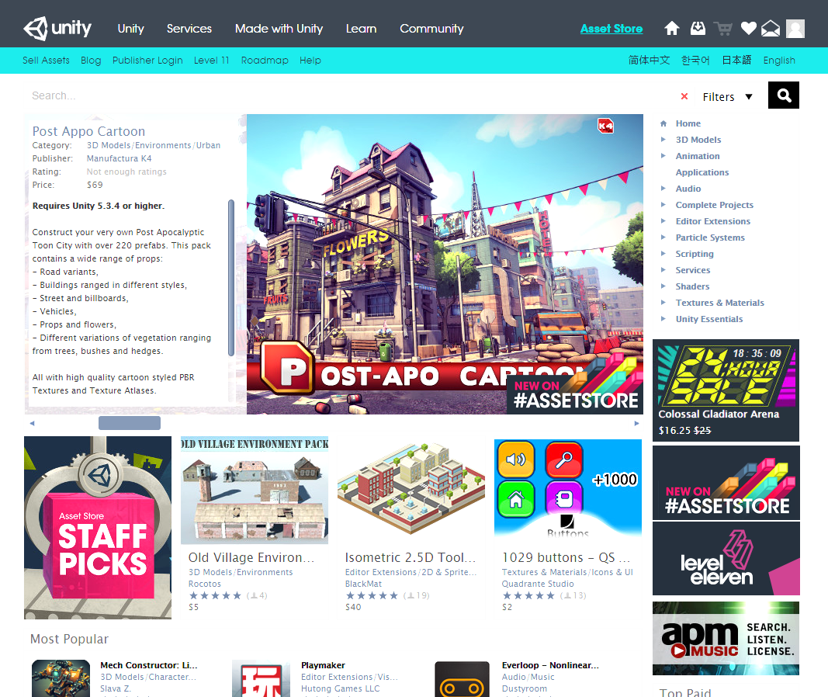
https://www.assetstore.unity3d.com/en/
Good Start:
Unity official free Package Unity Essentials
It contain a collection of assets, scripts, and example scenes.

Slide 28

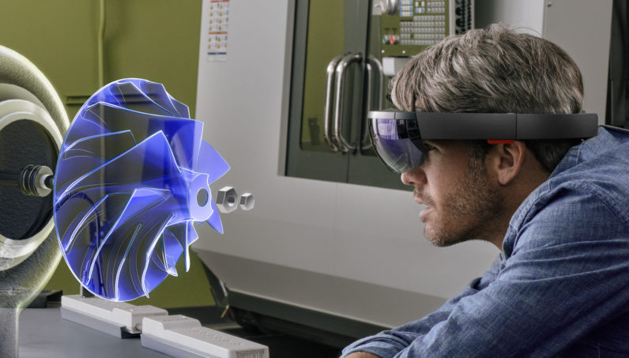
External Devices
Assets and Setup
Oculus Rift
https://developer.oculus.com/downloads/unity/
HTC Vive
https://www.assetstore.unity3d.com/en/#!/content/32647
VRTK - Virtual Reality ToolKit
https://www.assetstore.unity3d.com/en/#!/content/64131
Hololens
https://developer.microsoft.com/en-us/windows/mixed-reality/unity_development_overview
My Personal Tutorial- https://drive.google.com/open?id=1xOOntVne2_D6OprX0WWt7Ht6kDlkm4G3MHUBQ7uJ1Vs
Google Tango
https://developers.google.com/tango/apis/unity/
Leapmotion
https://developer.leapmotion.com/unity#116

Slide 29
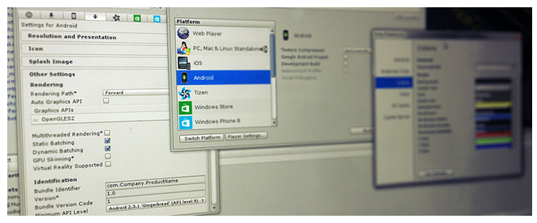
Build and Run
Save Scene as “scene_name”
Press File -> Build Settings -> … -> Build / Build And Run
Notes:
AR VR Deploy

Slide 30
